Slide 1
University Management System

Slide 2
Submitted by:
Sahil Koundal(102813)
Priya Chauhan(102458)
Shubham Chaudhary (102483)
Shivansh Sethi(102480)
Ripudaman Singh Tomar(102811)
Samridhi Kumar(102473)
Ravina Sharma(102462)

Slide 3
Preface
This project is aimed at developing an online University Admission System (UAS) for applicants.
This is a web based application that can be accessed throughout the web.

Slide 4
The Administration staff can add/update/delete any program that the university offers.
Members of admission (MAC) committee have the responsibility to filter the candidates for a specific program on the basis of application data and interview.

Slide 5
Acknowledgement
This project would never be a success without the constant guidance and support of our mentor Mr. Rahul Vikash and all the other teachers who taught us.
With their help, our concepts were made crystal clear.
We would like to thank them for making us capable enough to finish this project.

Slide 6
Introduction
University admission or college admission is the process through which students enter tertiary education at universities and colleges.
University wants to computerize its admission process for higher education courses.

Slide 7
Basic objectives are to extend their reach to geographically scattered students, reducing time in activities and centralize data.
Main challenges are effectively sync internal and external operations such that the job can be finished within time.

Slide 8
Existing System:
The Current System is a browser which is not totally computerized especially for university admission process.
The system takes lots of time in performing different activities, and there is no centralized data handling. There is no integration in the current system upon common data format.

Slide 9
Proposed System:
The Proposed system is a browser which is completely related to internet browsing.
The web enabled information management system designed to automate the entire operations of a modern.
This system allows multi-divisional, multi-department system handling that includes various activities.

Slide 10
Components
The admission system basically consists of three important parts:
Administrator
MAC(Members Of Committee)
Applicant

Slide 11
Applicant
The applicant is the person who wishes to apply for a particular program in the university.
The applicant can:
View all programs scheduled.
Apply online for a scheduled program by filling up the application form that auto generates the app ID.
View the application status, based on the application ID.

Slide 12
Administrator
Administrator is a group of people who have the ultimate record and authority over the entire organization.
The Admin staff should be able to:
Login to the system using his/her credentials
Update and manage (add or delete) information of the programs offer by the university

Slide 13
Manage (add or delete) schedules of the programs offered by the university
Generate various reports like:
View List of applicants confirmed/ accepted (waiting for interview)/rejected for a scheduled program.
View list of programs scheduled to commence in a give time period

Slide 14
MAC
Members Of Committee(MAC) is responsible for keeping in track all the applications(including accepting and rejecting applications) for a particular program and sending the conclusive information to Administrator.
MAC should be able to :
Login into the system using his/her credentials.
View applications for a specific program.

Slide 15
Accept/Reject an application on the basis of the details of the applicant. If accepted, fill in the scheduled date for an interview of the applicant before confirming the applicant to take the program.
After the interview, update the status of the application to Confirmed/Rejected

Slide 16
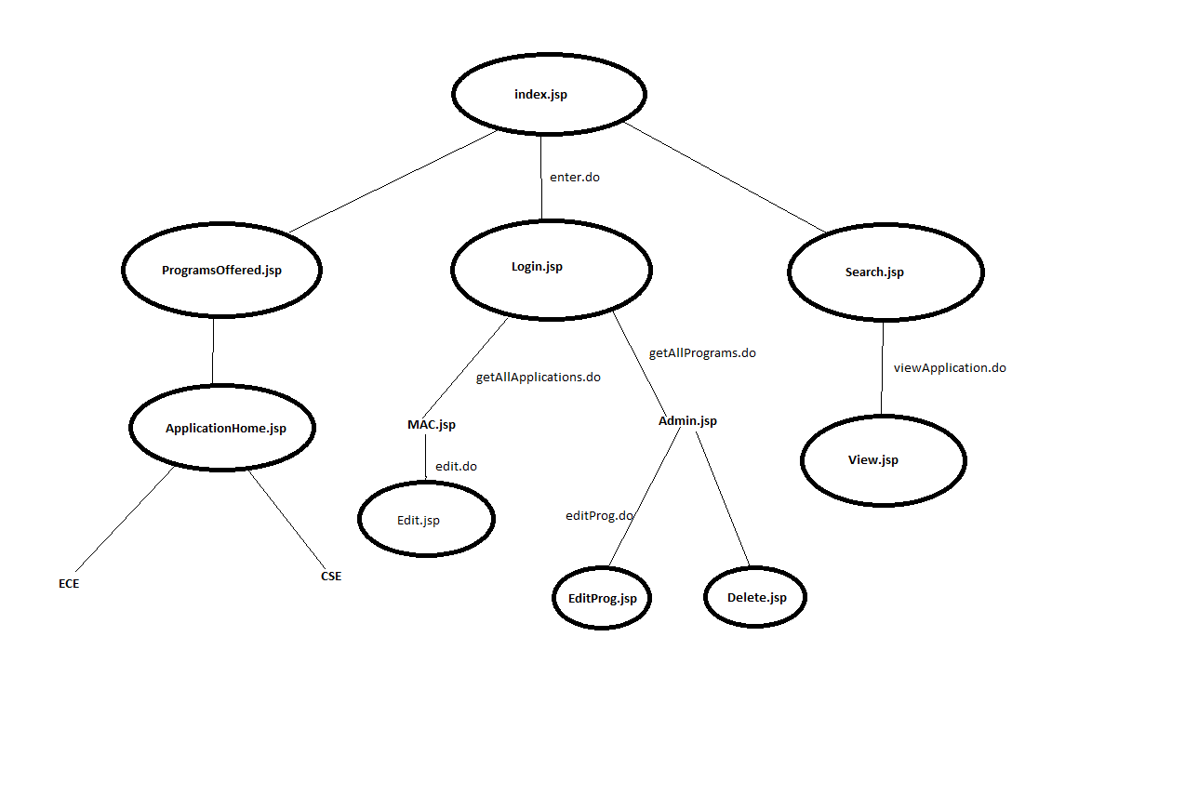
Application flow

Slide 17
Applications
Applicants’ Convenience: One advantage is that applicants can choose to submit their applications at their convenience.
Advantage to universities: Universities and educational institutions are also at a major advantage.

Slide 18
Advantages
Admission system becomes a lot more organized and easy with the help of online management systems.
We can manage registration for various constituencies in one database.
We can provide online registration for students, an automated ID will be generated which can help them access their application status.

Slide 19
Increases Accuracy and Efficiency: There is a high fatigue and monotony involved in the paperwork is a catalyst for errors.
Demolishing Geography: It makes it possible for candidates from across the country and even abroad to apply to Indian universities without any hassles.

Slide 20
Bibliography
http://www.freeproject.co.in/source/University-Admission-System.aspx?pf=Java&t=web
https://en.wikipedia.org/wiki/University_and_college_admission
http://www.mapsofindia.com/my-india/education/online-admission-system-advantages-and-disadvantages

Slide 21
Thank you.

